Slide 1
Report on Supermarket Sales Analysis
Prepared by Shakil Ahammed

Slide 2
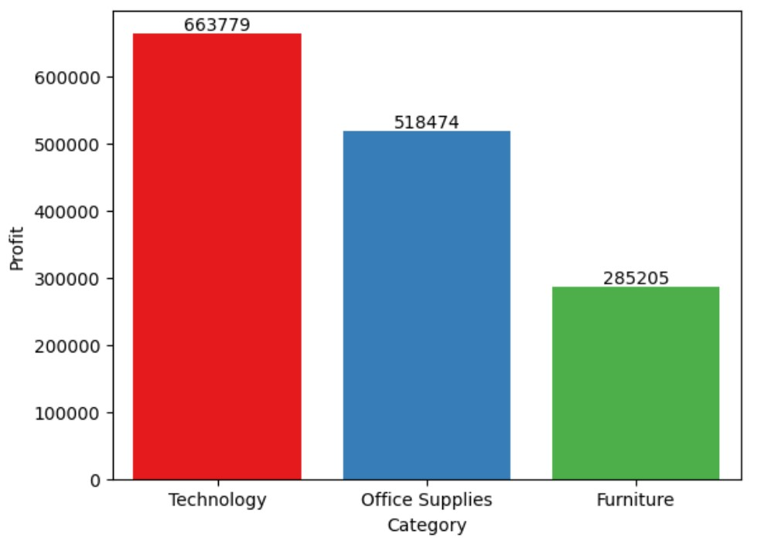
Insights
The top profitable category is Technology, Office Supplies, and Furniture.

Slide 3

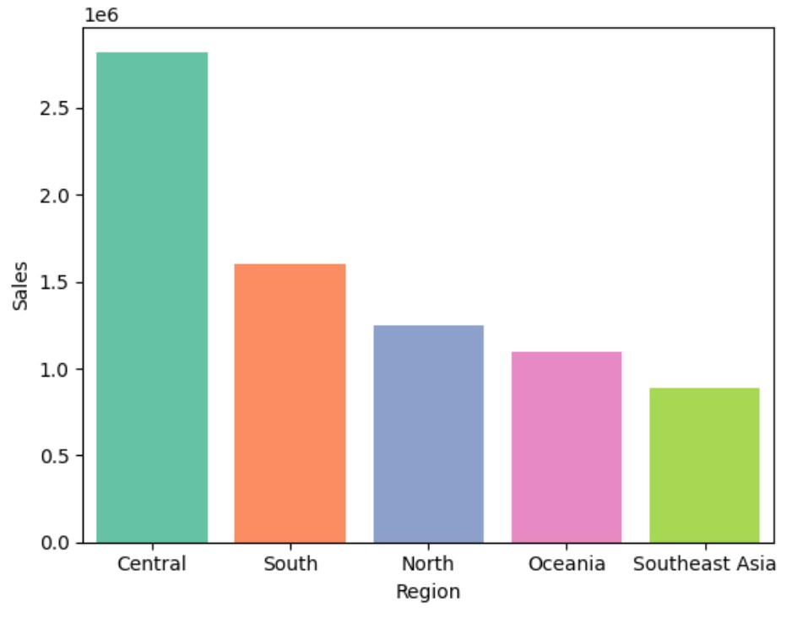
The top sales regions are Central, South, and North Region.

Slide 4
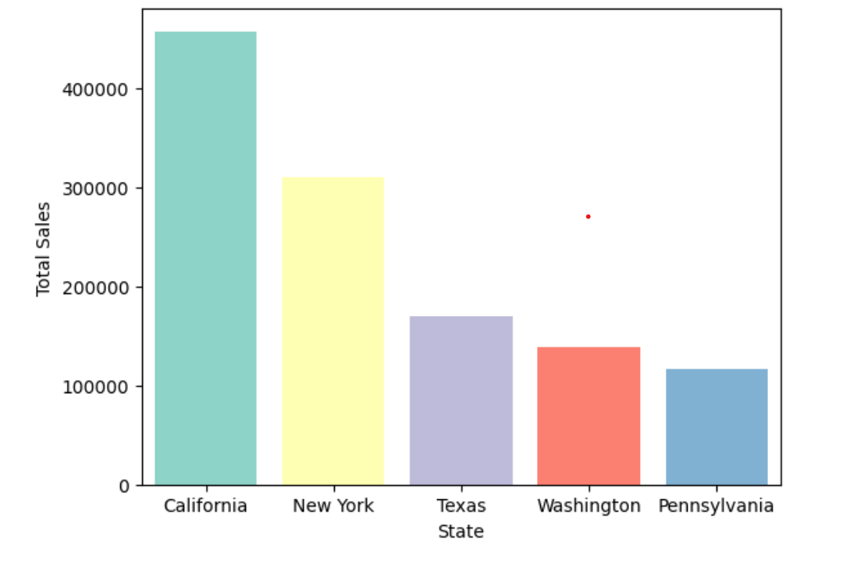
The top sales States are California, New York, and Texas.

Slide 5
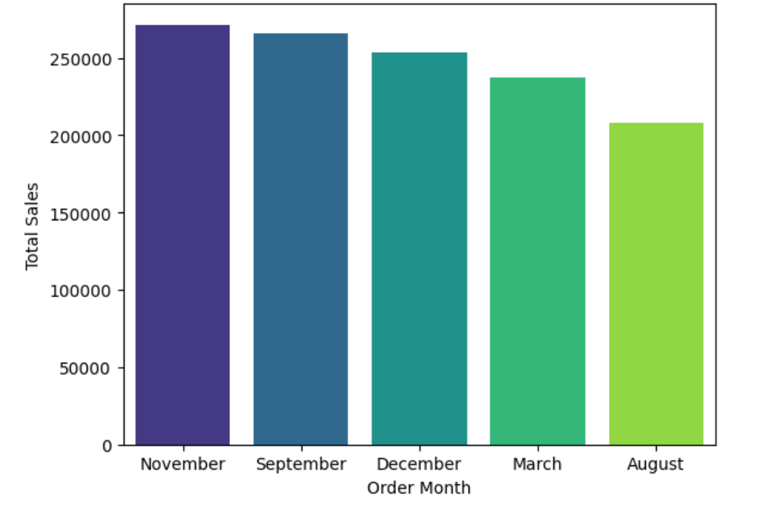
Most of the sales are generated in November, September, and December.

Slide 6
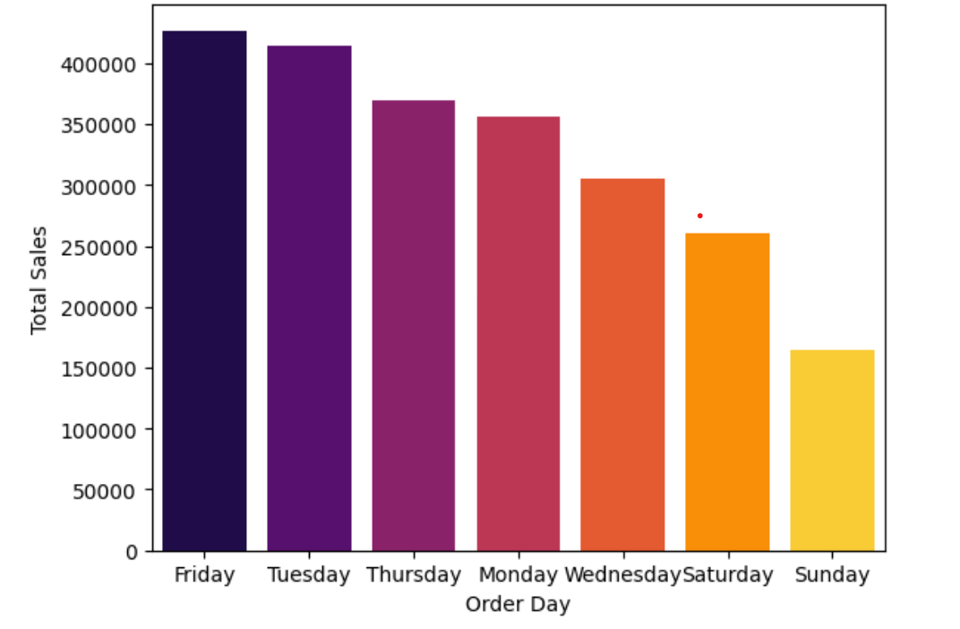
Most of the sales are generated in Friday, Tuesday, and Thursday.

Slide 7
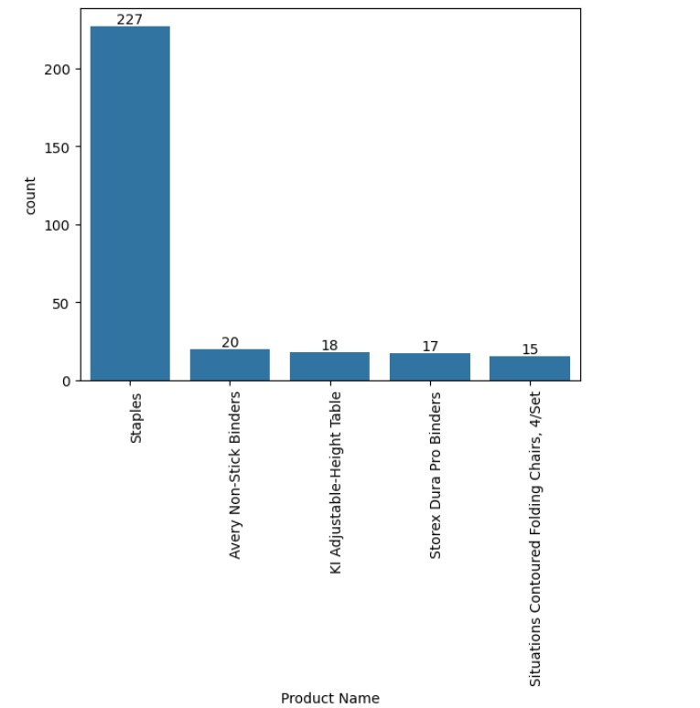
Insights
Most popular product is Staples, Avery Non-Stick Binders and KI adjustable –Height table.

Slide 8
Conclusion
The data shows that the most profitable category of products is Technology, followed by Office Supplies and Furniture. This suggests customers are willing to pay more for high-tech items and essential office equipment.
The data also reveals that the Central, South, and North regions are the top sales regions, accounting for most of the revenue. This indicates that these regions have a higher demand for the products or a more effective marketing strategy.
Additionally, the data indicates that the peak sales months are November, September, and December, which coincide with the holiday season and the start of the school year. This implies that customers buy more products during these periods, either for personal use or as gifts.

Slide 9
Conclusion
Furthermore, the data shows that the most sales are generated on Friday, Tuesday, and Thursday, which are the weekdays with the highest traffic and activity. This suggests that customers prefer to shop online during the work week, rather than on weekends.
Finally, the data reveals that the most popular product is Staples, followed by Avery Non-Stick Binders and KI adjustable –Height table. This implies that customers value quality, durability, and functionality in their products.
The data also shows that the top sales states are California, New York, and Texas, which are the most populous and economically developed states in the US. This indicates that these states have a larger customer base and a higher purchasing power.

